Slide 1
Adobe Analytics Challenge
MGM Resorts
Group 6
Wizkers
Sreeram Jayaram
Narayanan Padmanabhan
Venkata Naga Satya Sangeeta Eluri

Slide 2
Agenda
Key Performance Indicators
Goals/ Key Business Requirements
Analysis and Insights
Future Recommendations
Success events

Slide 3
Goals/ Key Business Requirements
Opportunities to Improve future conversions/bookings
Revenue growth
Decrease in friction (conversion/revenue prevention) points.
Understanding consumer behaviour and market shift
Increase site engagement

Slide 4
Increase in entertainment opportunities
Look for how other products get impacted by improving entertainment sector in MGM resorts
Consumer attitude and preferences
Impact of OTA
Traffic from OTA’s
Revenue from OTA’s

Slide 5
Success Events
Improve Conversion:
Increase subscriptions
Decrease fall out for designated marketing path
Visitor traverses with/without distractions to eventually make a reservation
Increase in Entertainment Opportunities:
People booking entertainment from various geographical locations
People booking rooms/dining along with entertainment
Impact of OTA
Visitors reserve through OTA’s

Slide 6
Key Performance Indicators
Improve conversions and change in customer behaviour:
Fall out analysis (people entering and converting eventually)
Reservations per promo clicks
Percentage reservations(room/dining/entertainment) per visit
Time spend on site
User Experience
Increase in Entertainment opportunities
Reservations (Entertainment,Rooms,Dining)
Reserved from which US States
Show names/timing, Show impact on other products
Impact of OTA’s
Marketing channels
Entertainment filters
OTA Revenue

Slide 7
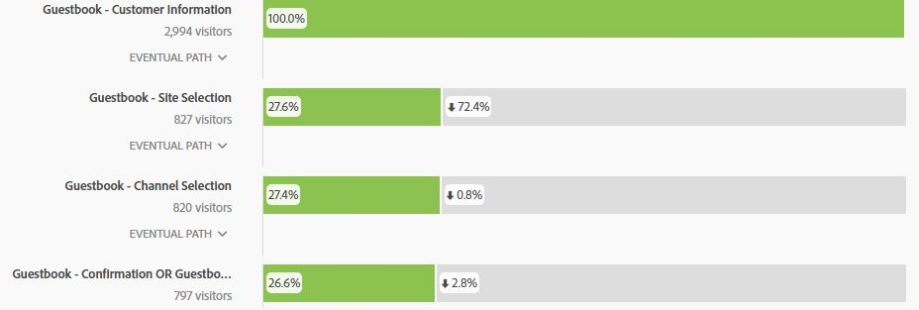
Site engagement analysis
Only 26.6 % convert. People fall out of customer information page and go to resort’s home page in order to proceed with activities such as searches and booking, rather than subscribing.
Notes:
By improving “time-spent” by visitor on MGM’s site, the engagement factor could improve.
Similarly, collecting email ID’s and information of visitors is a great way of driving visitors back to your website and increasing engagement whenever you have something new to say.

Slide 8
Traffic analysis
MGM properties have got people from DMA’s other than Vegas, who make reservations or pay a visit.
Mobile device usage rate > improve user experience
Paid search > Referrers
With shifting market needs and customer behaviour, MGM resorts could focus on social network sites to drive people.
MGM resorts could increase brand awareness with increasing clicks and shares.
Notes:
To generalize, considering three properties – “ MGM Grand, Bellagio, Aria”, over the last six months, we could see that visitors and reservations are more or less fluctuating, similarly. Traffic from paid search channel has been low compared to other sources. Therefore, bidding strategies need to be reconsidered in order to drive traffic through the same.
For each of the properties that MGM resorts has, people from Las Vegas use mobile devices to access them as opposed to people from other DMA’s, who use other devices.
On the other hand, “social networks” – referrer, accounts to very less(0.2%) or zero % of entertainment compared to other referrer types. Hence, focusing on sites like FaceBook and Instagram could be fetching.

Slide 9
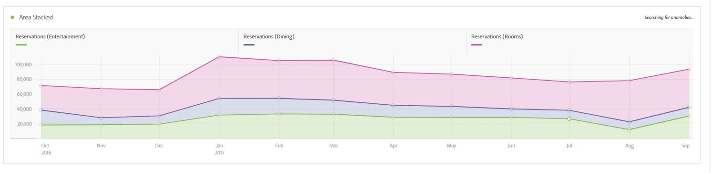
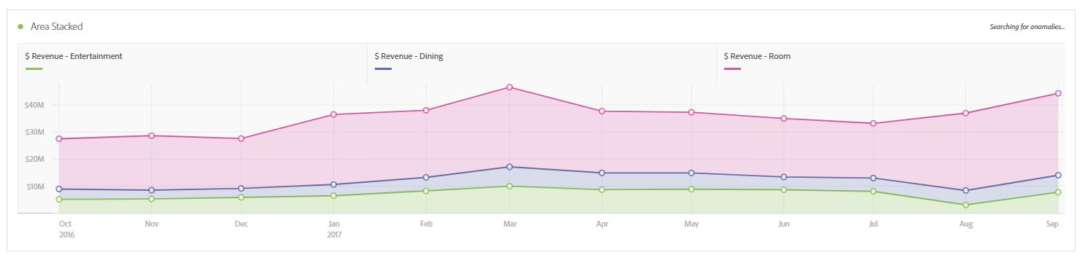
MGM Revenue and Reservation Trend

Slide 10
Impact of Entertainment:
Room and dining reservations increases with increase in entertainment reservations.
On an average, 4.5% of people who come for entertainment also reserve rooms.
Around 1.4% of people reserving entertainment are likely to dine.

Slide 11
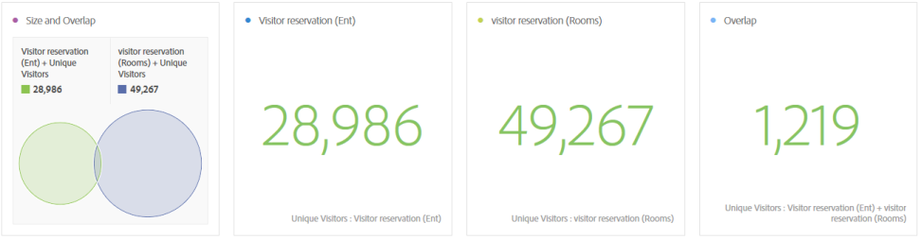
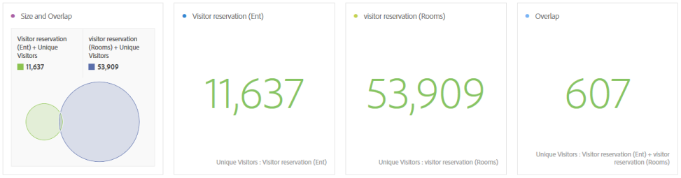
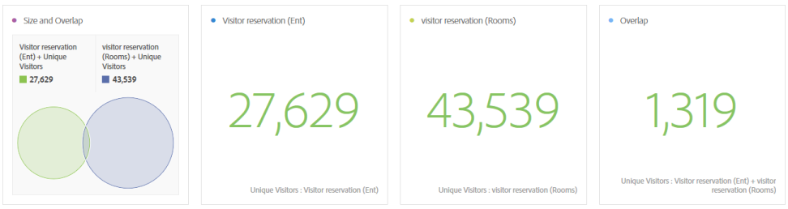
Impact Of Entertainment On Room Reservations
Time | Percentage of visitors reserving for entertainment and dining to visitors reserving for dining | Dashboard
Sep 2017 | (1,219/28,986)*100 = 4.205%
Aug 2017 | (607/11,637)*100 = 5.216%
Jul 2017 | (1,319/27,629)*100 = 4.773%
Notes:
Room and dining reservations increases with increase in entertainment reservations.
On an average, 4.5% of people who come for entertainment also reserve rooms.

Slide 12
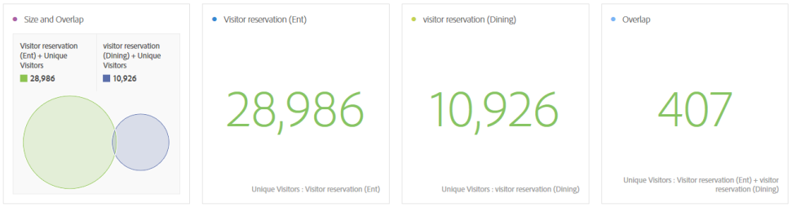
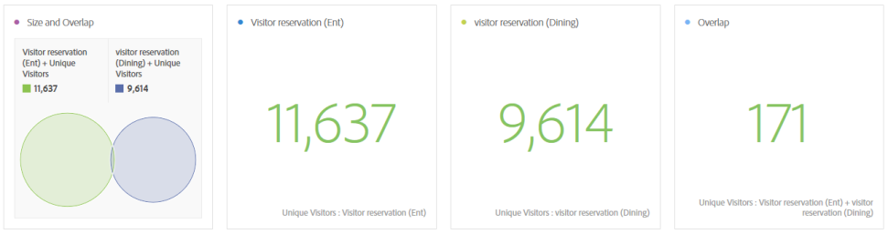
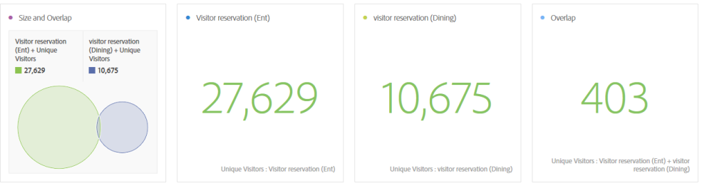
Impact Of Entertainment on Dining Reservations
Month | Percentage of visitors reserving for entertainment and dining to visitors reserving for entertainment | Dashboard
Sep 2017 | (407/28,986)*100 = 1.404
Aug 2017 | (171/11,637)*100 = 1.469
Jul 2017 | (403/27,629)*100 = 1.458
Notes:
Around 1.4% of people reserving entertainment are likely to dine.

Slide 13
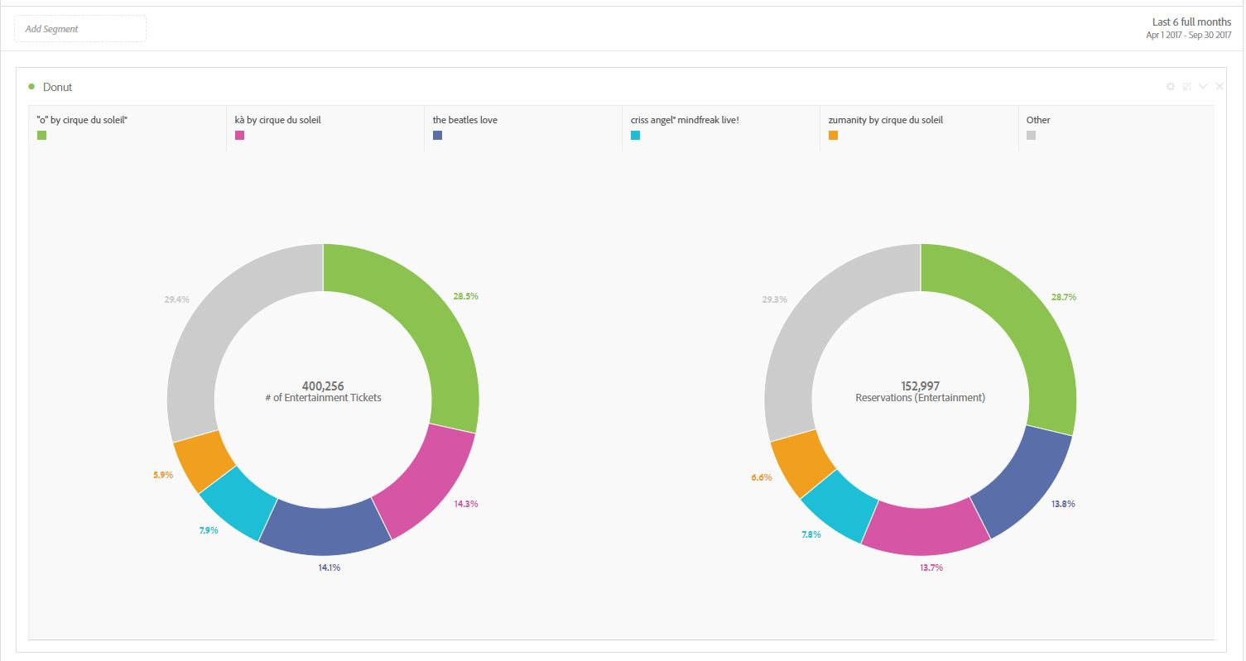
Entertainment

Slide 14
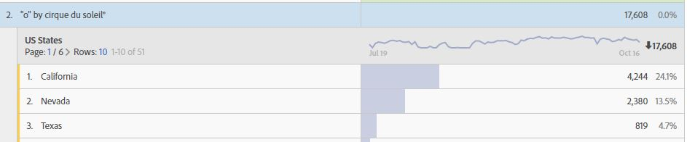
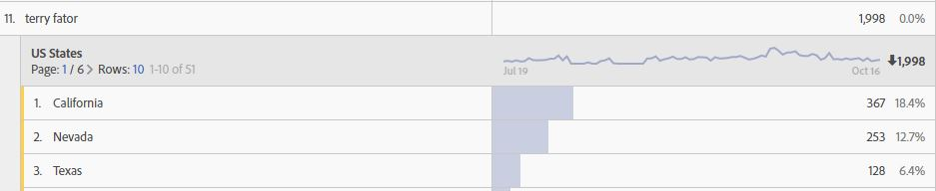
Customer Preferences/Behaviour

Slide 15
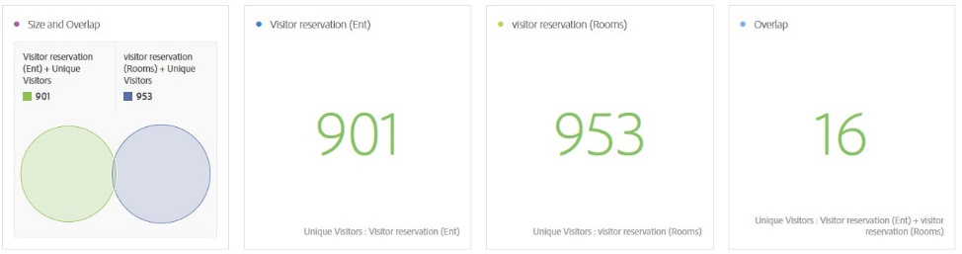
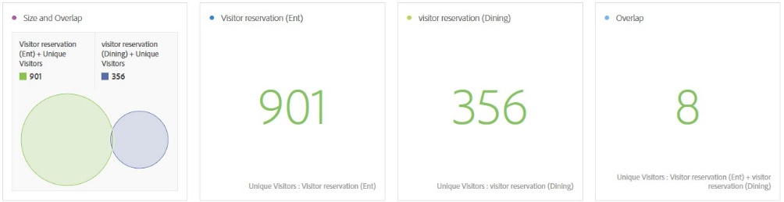
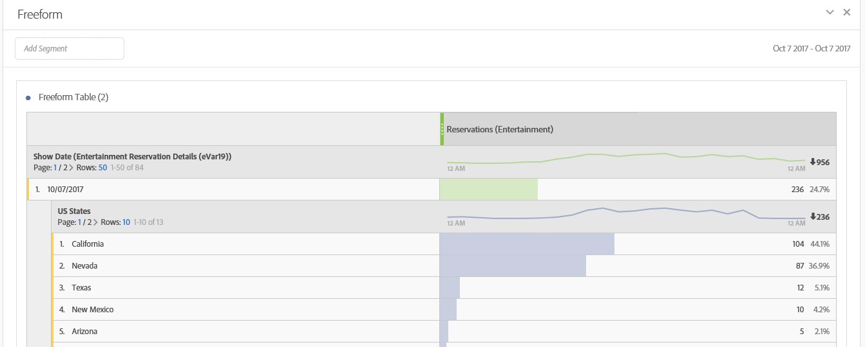
Travelling Customers
Notes:
On October 7th, customers booked entertainment, room and dinning. 16 customers booked both room and entertainment.
And, only 8 customers booked dinning and entertainment.
For instance, there are customers who come from states like Texas, Florida, Colorado, California etc., to see Cirque du Soleil Shows.
These customers would have travelled, a long distance, from their state to see these shows and they would have stayed in different hotels.
If we target these customers by giving promotions for rooms and offers for dinning, when they book show tickets, we will get more revenue to the company.

Slide 16
Insights
Since MGM has good number of entertainment reservations, they could Target customers, who come for entertainment by providing them offers and discounts in rooms and dinning.
We can provide discounts in rooms & dinning for customer who lives in Texas, Florida and book the entertainment shows.
Similarly, main entertainment events happen at 7:00 PM and 9:30 PM, when most of the customers book for shows. Hence, MGM could provide more promotions on dinning to attract these customers .
All of the above, eventually improves the revenue.

Slide 17
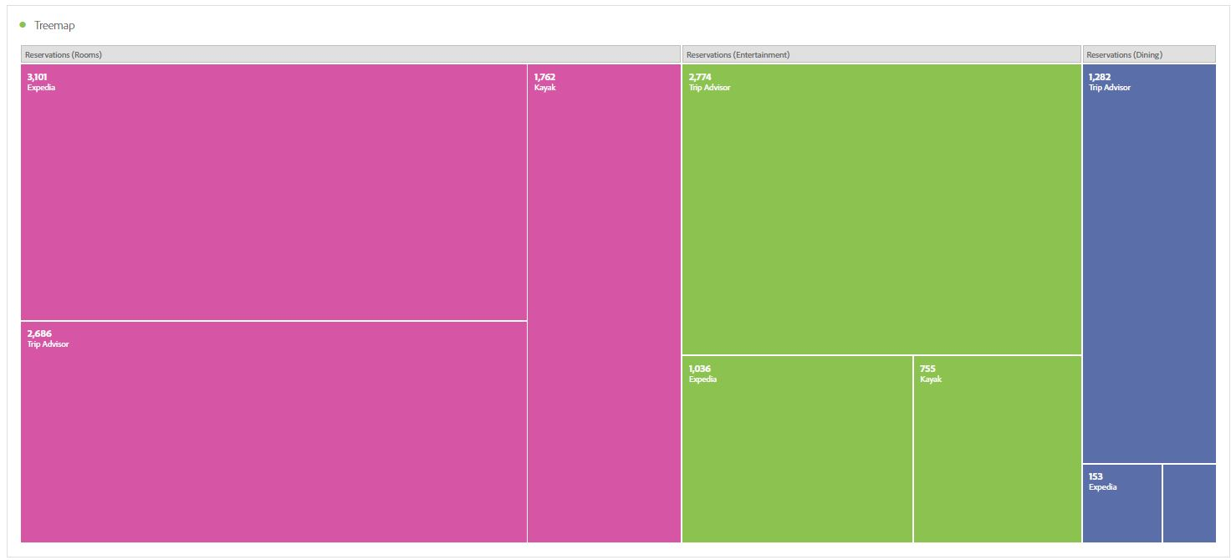
OTA Impacts

Slide 18
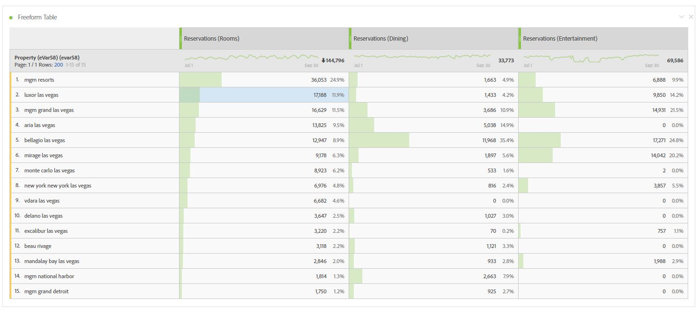
MGM Properties

Slide 19
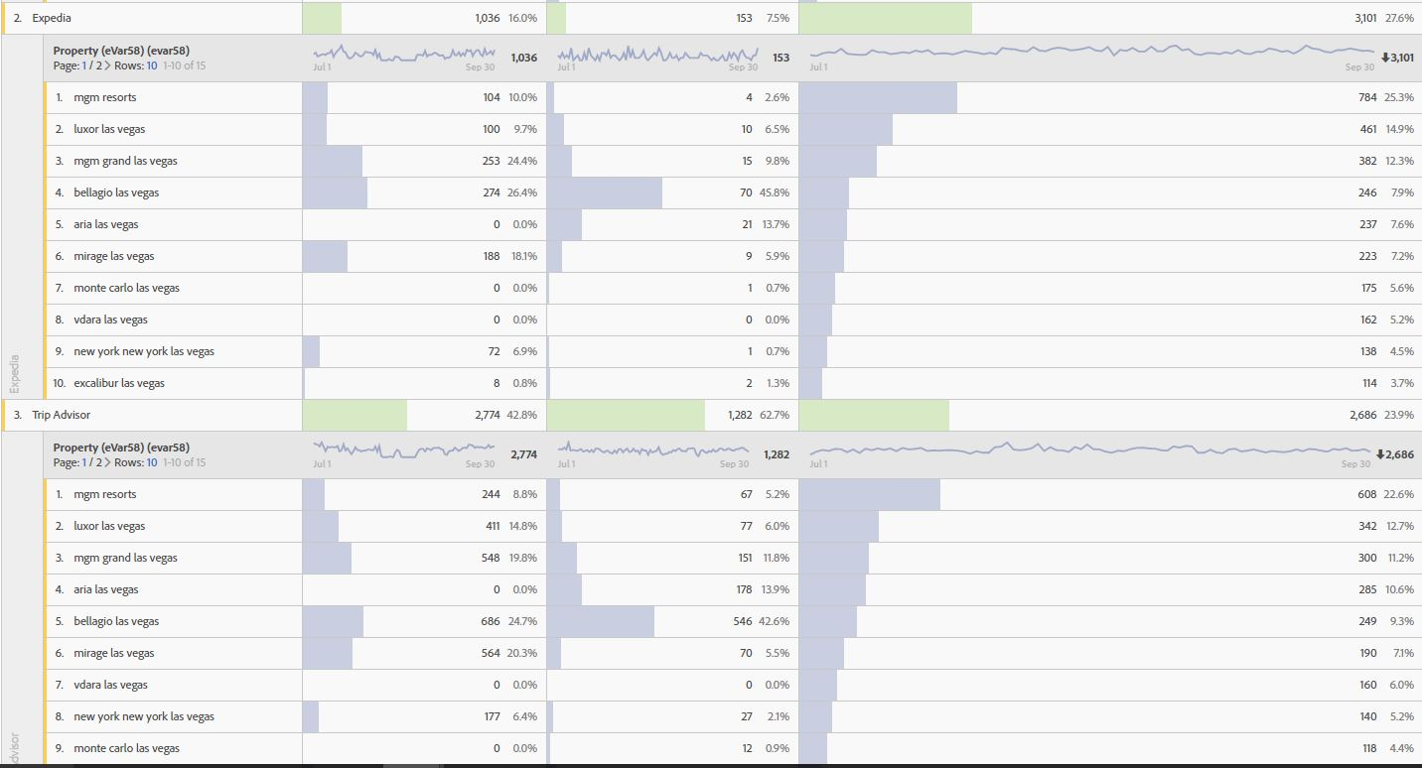
MGM properties - bookings using OTA’s
Notes:
Chosen OTA’s – Expedia, Trip advisor

Slide 20
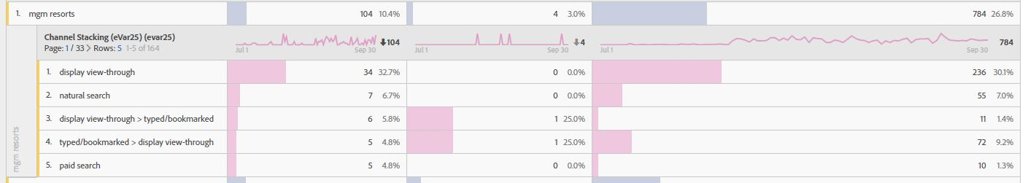
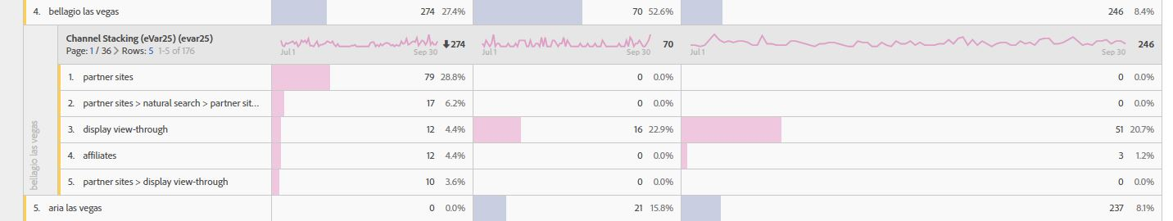
Marketing Channels
Notes:
Marketing channels for – MGM Resorts and Bellagio

Slide 21
Insights
OTA’s like TripAdvisor, Expedia have great impact on MGM properties.
Since most of the revenue is generated using Display- View through, MGM could invest in these websites to promote more “Display- View” through adds and increase their display time. This would eventually increase the revenue.
Also, MGM needs to continue with partner sites as is.

Slide 22
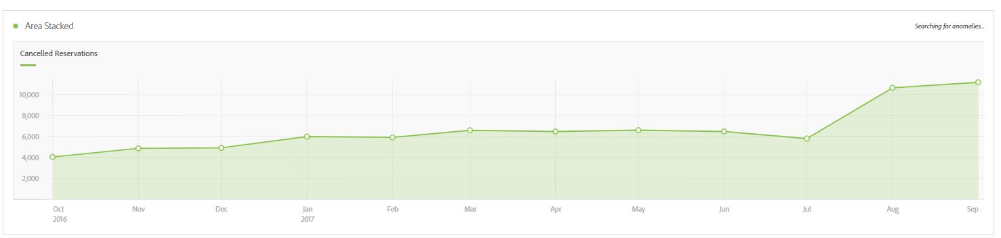
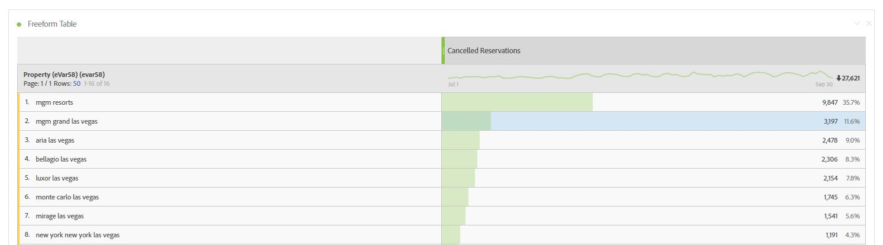
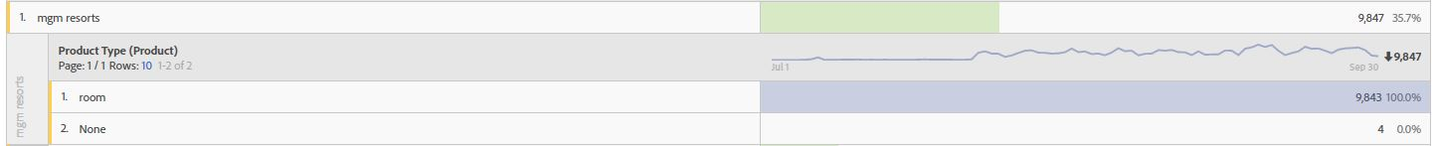
Cancellation- Trend

Slide 23
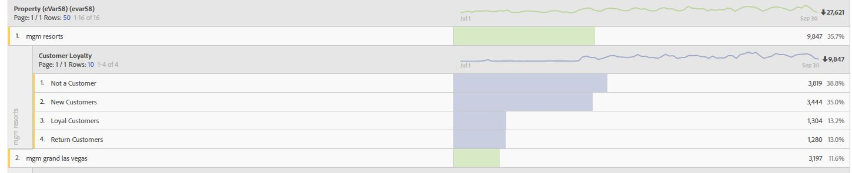
Continue- Cancellation
From previous charts, we can clearly see that most of the cancellations are of rooms.
Revenue for MGM has decreased during August till September.
Ratings, reviews and feedbacks play an important role.
Notes:
From the above chart, irrespective of customers Loyalty, the rooms are being cancelled. MGM has to look into this and should check whether there are bad rating for MGM rooms.

Slide 24
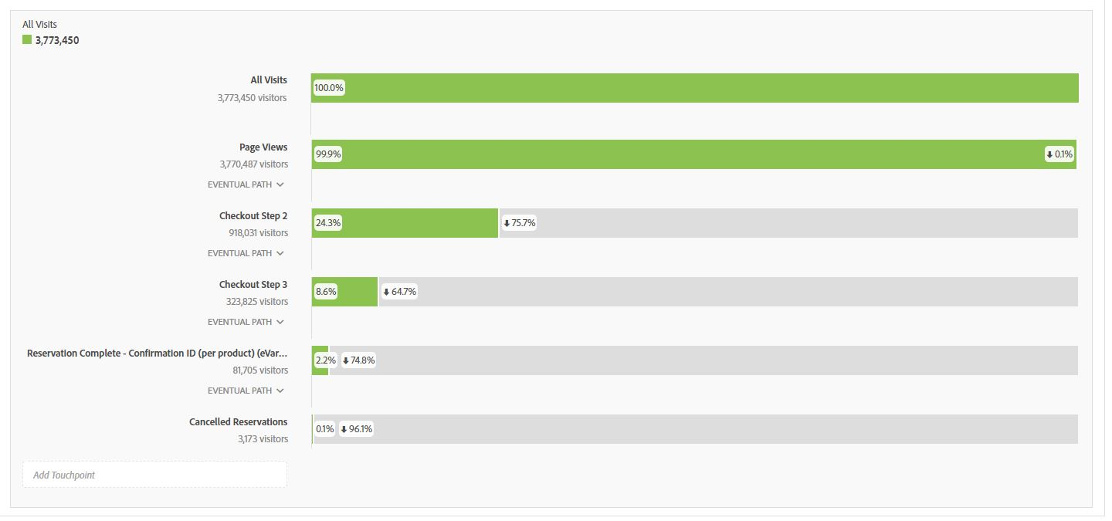
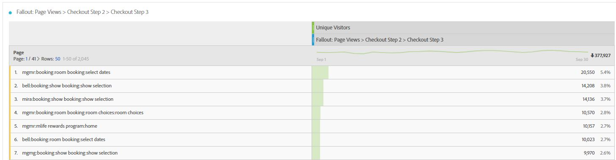
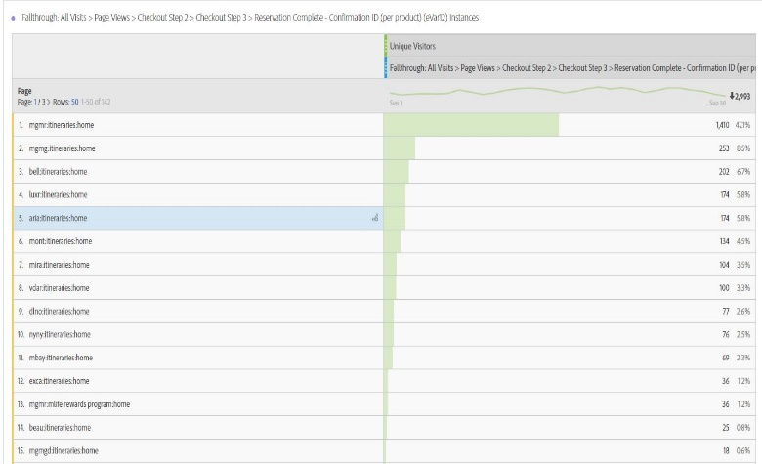
Room Booking Funnel
Conversion funnel – Last Month
Out of 323,825 Visitors only 80,705 get converted. In them, there are customers who usually save their selections to itineraries and eventually, book their rooms.
Notes:
This shows that many customers are in dilemma and probably, are exiting from reservation. Also, we created a flow analysis to see customers activity. This has given a similar outcome.

Slide 25
Insights
From flow analysis and funnel outcome, customers seem to have been oscillating (to book the rooms - customers checks the prices and change their selection criteria to fetch optimized price many a times and eventually, exit from the page).
Customers save their choices in itinerary and book later. MGM could send periodic mails to remind them of their save.
Therefore, MGM needs to have more engaging features on their pages to attract customers.
Cancellation, in recent days, has been more in rooms. So, there might be bad reviews or some good deals in other hotels, which would have lead to high cancellation. MGM might need to consider hotel reviews and check why cancellations have been high

Slide 26
Future Recommendations
Target the segment that distracts from the flow and eventually doesn't make a conversion.
New inclusion: Session time outs prevents persistence in data. Persuade users to login so that their search path is saved for them.
Persuade people from far of places to take rooms, with attractive offers.
As mentioned, people coming for entertainment from “California, Texas” could be offered a discount on the rooms so that they consider booking rooms, to improve revenue.
Notes:
Visitors either logged in / not logged in have multiple behaviours. They tend to deviate a lot from a designated flow.
For example, in the room booking scenario, they go back and forth multiple times between “select dates” and “select room choices” to either select for a needed date or get a best deal on their chosen dates.
While making choices, the session might time out. Include a new feature to save their searches.

Slide 27

Thank you!!

